Slide 1


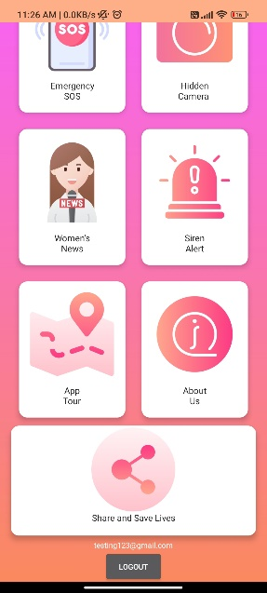
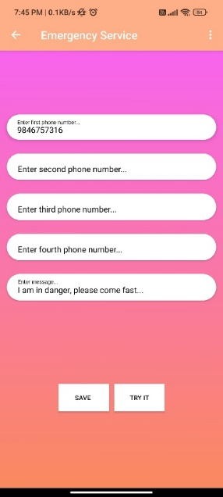
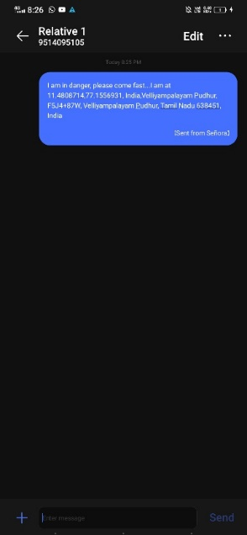
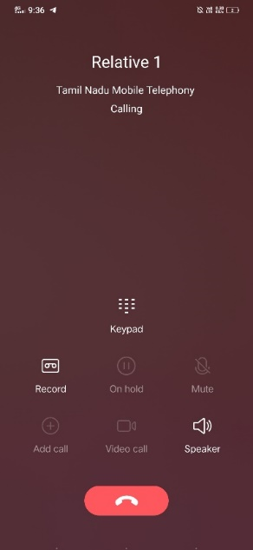
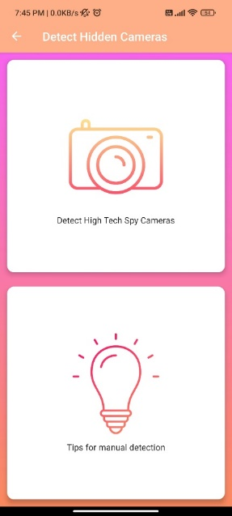
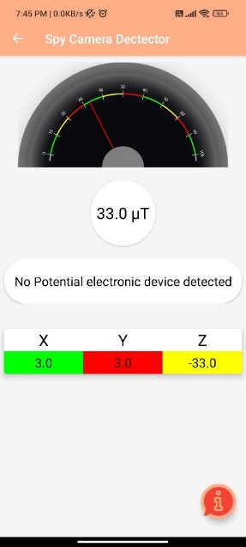

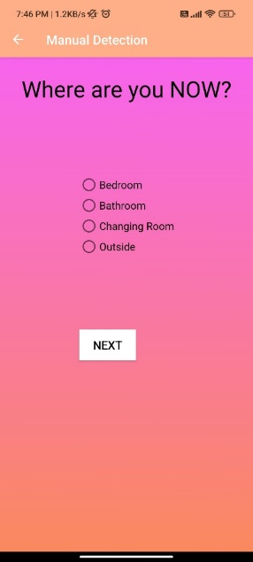
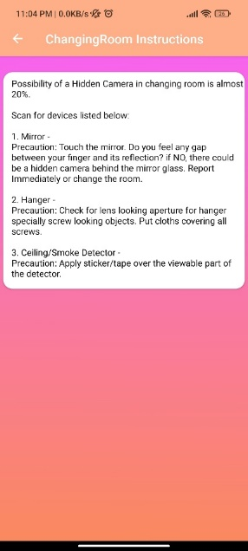
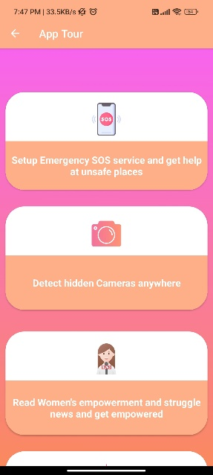
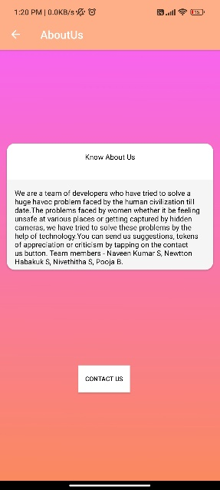
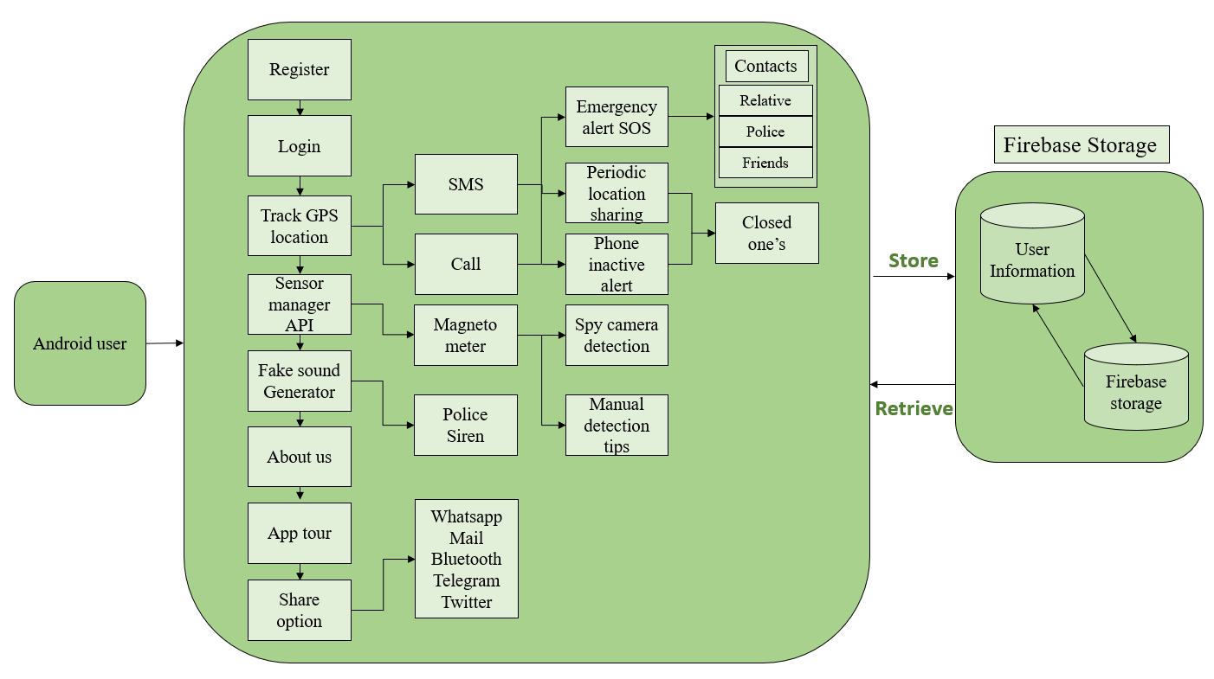
Women Safety App for Improved Personal Security Introduction Results
The safety of women has been a major concern in society for a long time. Incidents of harassment, violence, and sexual assault against women are unfortunately common in many parts of the world. The women safety app offers various features such as emergency alerts, GPS tracking, real-time communication with trusted contacts, spy camera detection, women’s news, and Siren alert to deviate the person. Any mobile device can access the app, which is simple to use. With just a single click, women can send an alert to their emergency contacts, providing them with their location and the nature of the emergency. In addition to emergency features, the app also includes safety tips and resources for women. It offers information on self-defense techniques, safety precautions, and legal rights. Furthermore, the app provides a community forum where women can connect with other users to share their experiences and seek support. | The women safety app would be to improve the safety and security of women, particularly in situations where they may feel vulnerable or threatened. The app could provide a range of features and services, including: Emergency SOS, Hidden camera detector, Women’s news, GPS tracking, panic button, 24 hour idle alert, safety tips, emergency alerts.
Motivation
Women face a disproportionate amount of violence and harassment, and women safety apps aim to address this need by providing a tool for women to feel safer in their daily lives.
Scope of the Project
The scope of this project included : The app may include safety features such as an emergency alert button, GPS tracking, and a panic alarm that can be activated in case of an emergency. The app may allow users to report incidents of harassment or violence, and provide feedback on safety levels of locations.
Methodology
The waterfall model is a sequential software development process that consists of several phases. Each phase must be completed before moving on to the next phase. The following is an overview of how the waterfall model can be applied to the development of a women safety app for improved personal security: 1) Requirement Gathering: In this phase, the requirements for the women safety app will be gathered. This will include identifying the app's target audience, the features required, and the expected outcomes. 2) Design: In this phase, the app's overall architecture and design will be created. The design will include wireframes, storyboards, and user flows to outline the app's features, user interface, and functionality. 3) Implementation: In this phase, the app's code will be written, and the app's features will be developed. This phase will involve both front-end and back-end development. 4) Testing: In this phase, the app will be tested to ensure that it meets the requirements and functions as expected. This will include functional testing, user acceptance testing, and performance testing. 5) Deployment: In this phase, the app will be deployed to the app store or other distribution channels. The app will be made available to the public and monitored for any issues that may arise. 6) Maintenance: In this phase, the app will be maintained, updated, and improved over time. This will include fixing any bugs, adding new features, and addressing any user feedback. Chatbot Architecture
 | Conclusion
 | In conclusion, a women safety app for improved personal security can be an effective solution for reducing incidents of harassment and violence against women. By providing emergency features, safety resources and tips, community support, and additional features, the app can empower women and provide them with the necessary tools to stay safe. The literature review highlights the importance of user-friendliness, accessibility, and ongoing development to ensure the effectiveness of such apps. It is essential to design the app in a way that is easy to use, with features that can be easily accessed in case of an emergency. In addition to providing immediate support and assistance during emergencies, a women safety app can also create a sense of community among women, allowing them to share their experiences and provide support to one another Overall, a comprehensive women safety app can be an effective tool in creating a safer environment for women. By promoting awareness, providing support and resources, and facilitating communication, the app can help women feel more secure and confident in their daily lives.
 | References [1] "Design and Development of a Mobile App for Women Safety Using IoT" by M. R. Abitha and S. V. Shilpa. (2020) [2] "Smartphone-based Women Safety Application using Machine Learning Algorithm" by A. Jain, A. Khampariya, and N. Jain. (2021)”
Naveen kumar S, Newtton Habakuk S, Nivethitha S, B Pooja
IV CSE B
Guidance: Aruna T N
Architecture Diagram

